Slide 1
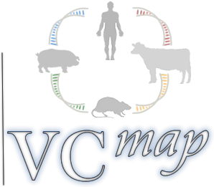





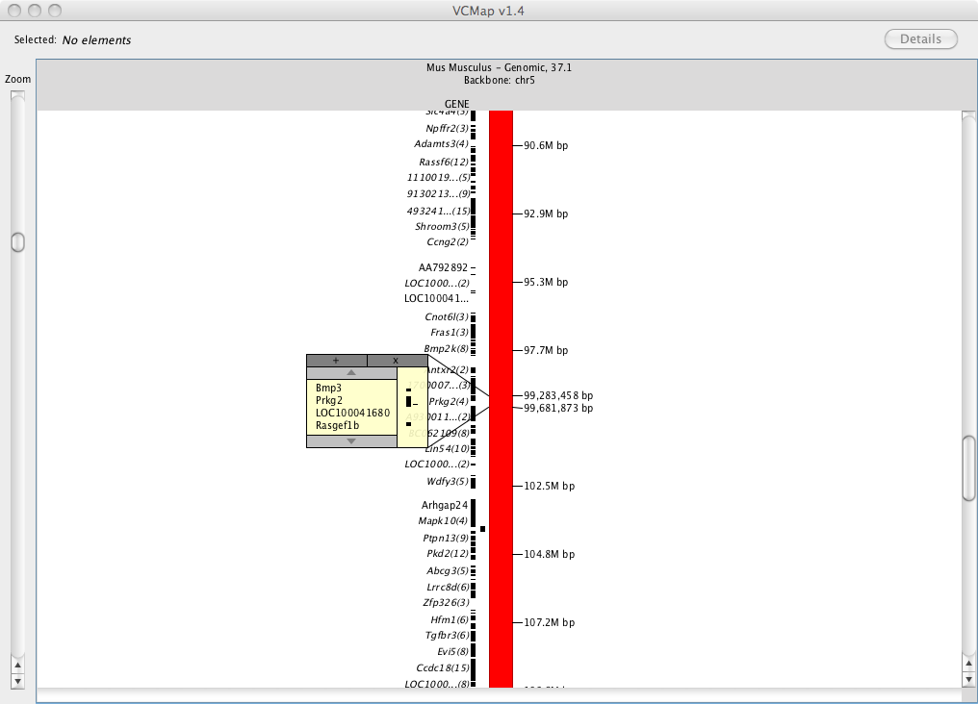
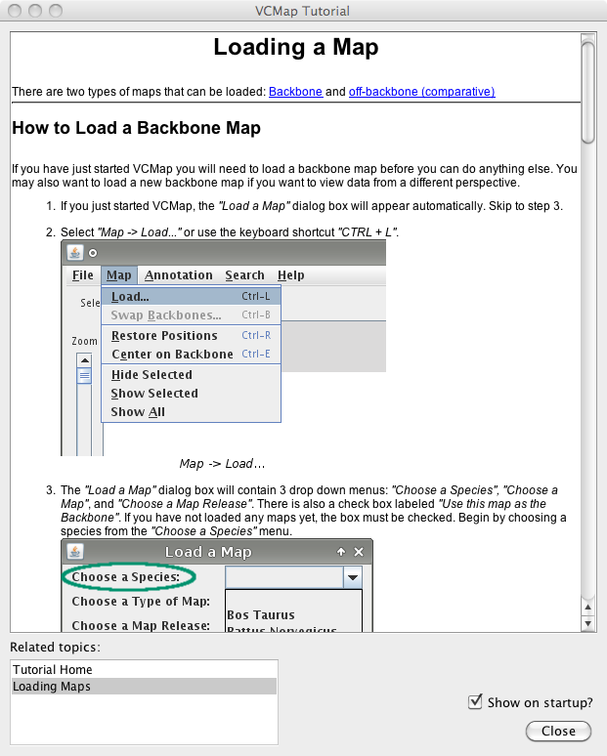
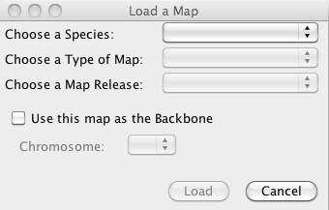
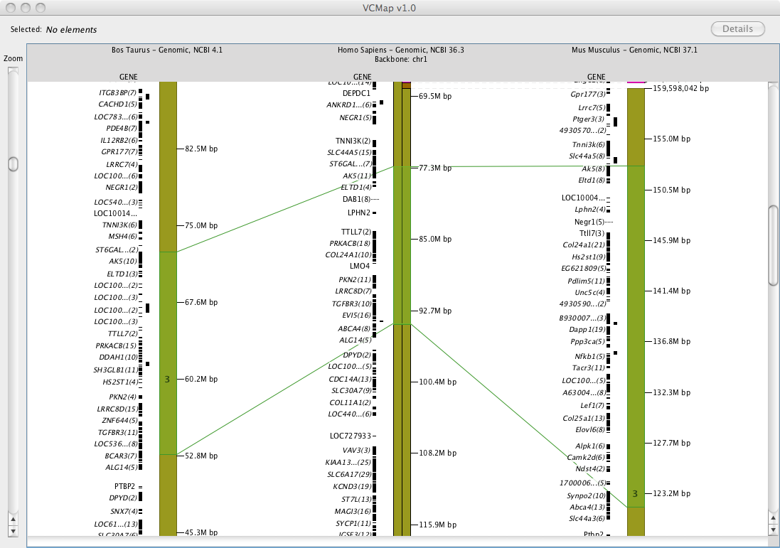
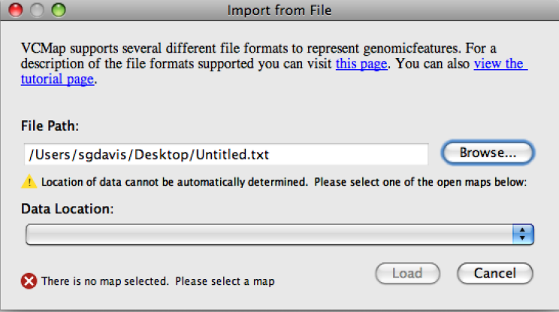
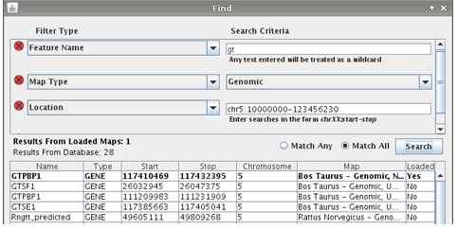
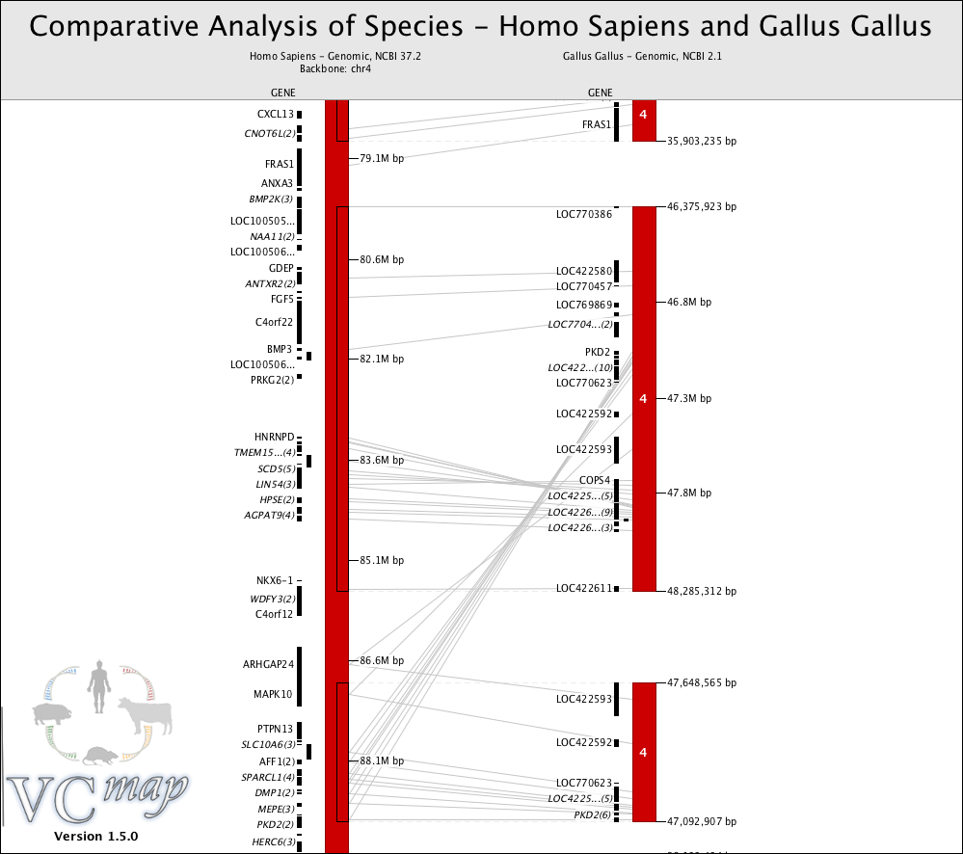
VCMap: A Comparative Genomics Viewer and
Database Designed to Facilitate Genomic Discovery
J.E. Koltes¹*, S.G. Davis²*, Z-L Hu¹, M. Shimomoya^{3,4}, M. Dwinell^{3,4}, A.E. Kwitek⁵, and J.M. Reecy¹
¹Iowa State University, Ames, IA, USA; ²Bio::Neos, Inc, Coralville, IA, USA; ³Medical College of Wisconsin, Milwaukee, WI, USA; ⁴Rat Genome Database;
⁵University of Iowa, Iowa City, IA, USA
OBJECTIVES
http://vcmap.bioneos.com or http://www.animalgenome.org
VCMap is a comparative genomics visualization tool.
Species currently supported include: chicken, cattle, mouse, pig, rat, and human genomes.
Comparative maps include: genetic, genomic sequence and radiation hybrid data.
GOALS: Facilitate integrated comparative genetics discovery by blending map data, annotation, and other genomic data that will facilitate discovery of major genes responsible for trait variation.
Allow seamless user data uploads and export of cross- species data and images.
1) Navigating the maps – loading the backbone
2) Follow the interactive tutorial
Select Map...Load from the Menu & Choose the backbone
Opens automatically with the software
Zoom In: Move the bar
Popup window:
Double click on a feature to link to NCBI and QTL databases.
APPLICATION & DATABASE
VCMap is written in Java is launched via Java Web Start for complete platform independence.
VCMap accesses a MySQL based relational database back-end.
The VCMap database contains:
  Gene and pseudo gene annotations
  Genetic and genomic map from NCBI, UCSC, and Ensembl (1,2,3)
  Radiation hybrid map data from Iowa State and the Evolution Highway at the University of Illinois (4)
  QTL annotation data from the Iowa State University's Animal QTLdb and the Rat Genome Database for each species (5,6)
3) Compare cross-species annotation
4) Load & visualize custom data
Map...Load from Menu, uncheck the backbone option
Load Annotation:
Add gene names, QTL, etc.
Select Annotation...Import from File
SUPPORTED DATA FORMATS
VCMap supports private user datasets in a variety of formats including:
GFF3, BED, BAM, SAM, and more.
Users can easily view private Genome-Wide Association Studies, SNP locations, DNA or RNA Next-Generation sequencing data, or custom annotations data.
Connecting lines:
The lines represents homologous regions and
features. Green connecting lines represent approximate homologous regions. Gray
connecting lines represent homologous annotation, and turn blue when selected.
Visualize Synteny:
VCMap aligns homologous chromosome blocks.
PLANNED FUTURE UPDATES
Inclusion of new tracks, including: gene expression, cross-species phenotype ontologies, SNP chip annotations.
Addition of more species.
Increase User flexibility to add custom data.
Expand use to facilitate visualization of Recombinant Inbred Lines.
5) Search for annotation of interest
6) Export & save for publication
Select Search...Find from the Menu
Select File...Export Image from the Menu
Find annotation for your species of interest:
VCMap can help you view cross-species annotation when annotation is sparse in a species of interest.
REFERENCES
View Evolutionary Rearrangements.
1 NCBI Gene database; http://www.ncbi.nlm.nih.gov/gene/.
2. UCSC genome browser; http://genome.ucsc.edu/.
3. ENSEMBL genome browser; http://uswest.ensembl.org/index.html
4. Murphy et al., 2005. Science 309: 613-617.
5. Hu et al., 2007. Nucleic Acids Research 35; D604-609.
6. Rat Genome Database; http://rgd.mcw.edu/
The Find function within the Search menu allows users to search and extract specific annotations, map and gene data.
For more information, contact:
jekoltes@iastate.edu, sgdavis@bioneos.com, jreecy@iastate.edu, zhu@iastate.edu
This project is supported by the USDA-NRI 2007-04187.

